Slide 1
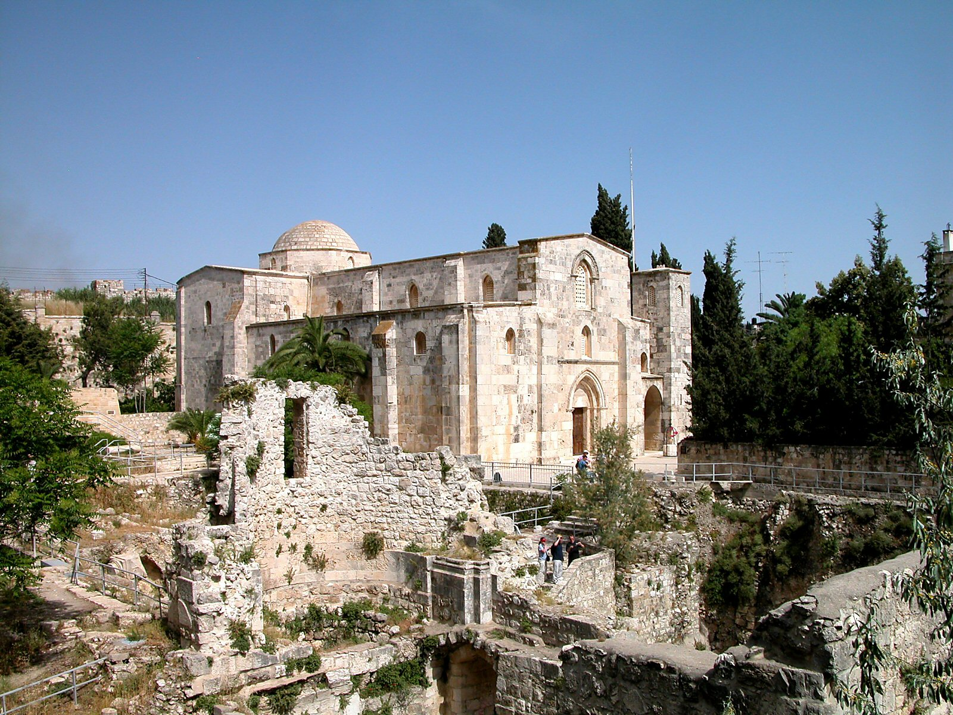
Ruins at site of Pools of Bethesda
St. Anne’s Church
John 5.1-18
Photo ©2006 Todd Bolen; BiblePlaces.com

Slide 2
John 5.1-3/4 [NET]: After this there was a Jewish feast, and Jesus went up to Jerusalem. Now there is in Jerusalem by the Sheep Gate a pool called Bethzatha in Aramaic, which has five covered walkways. A great number of sick, blind, lame, and paralyzed people were lying in these walkways.

Slide 3
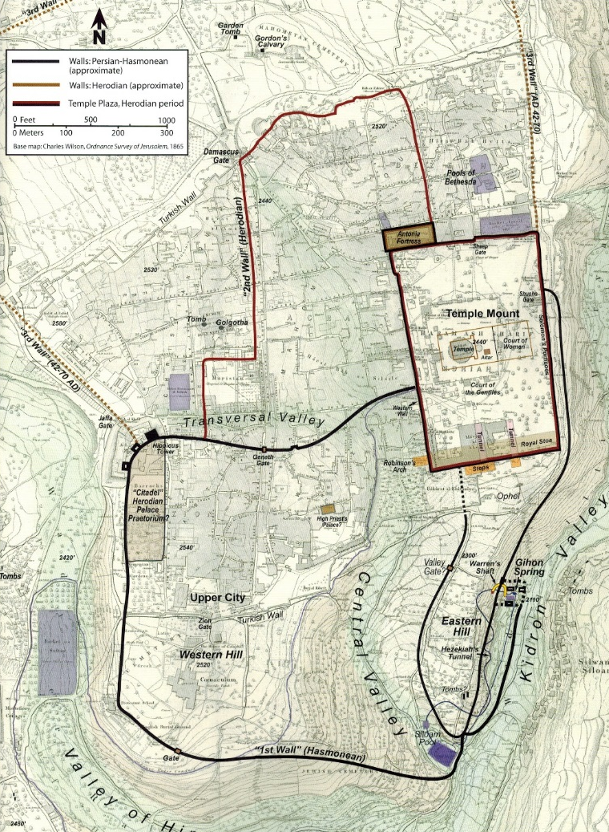
Pools
Sheep Gate
Temple Mount
Upper City
City of David
Map 11-2 from
Schlegel’s Satellite Bible Atlas

Slide 4
John 5.2-3: …a pool called Bethzatha in Aramaic, which has five covered walkways. A great number of sick, blind, lame, and paralyzed people were lying in these walkways.
Photo ©2006 Todd Bolen; BiblePlaces.com

Slide 5
John 5.5-9a: Now a man was there who had been disabled for thirty-eight years. When Jesus saw him lying there and when he realized that the man had been disabled a long time already, he said to him, “Do you want to become well?” The sick man answered him, “Sir, I have no one to put me into the pool when the water is stirred up. While I am trying to get into the water, someone else goes down there before me.” Jesus said to him, “Stand up! Pick up your mat and walk.” Immediately the man was healed, and he picked up his mat and started walking.

Slide 6
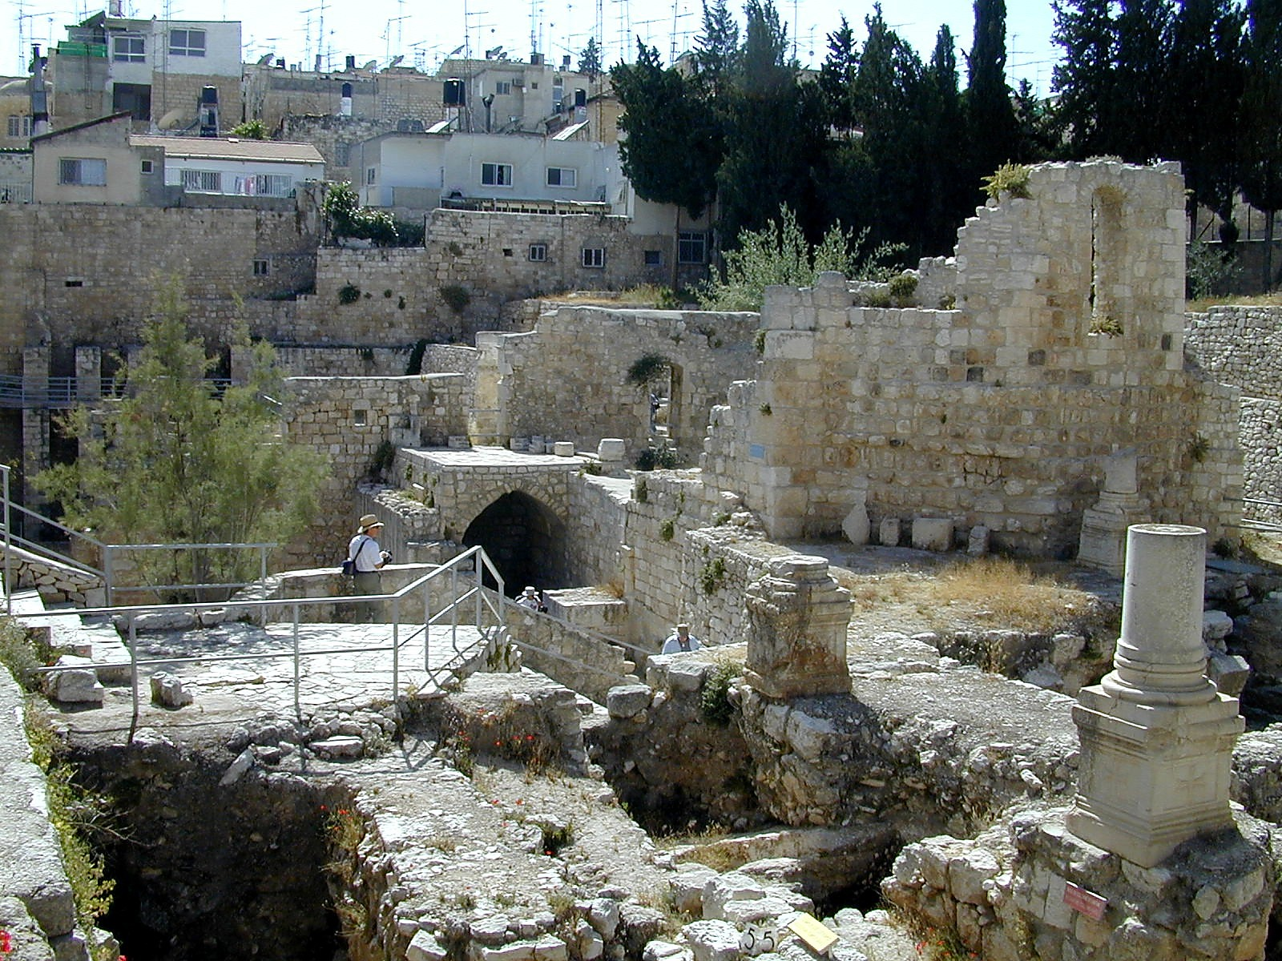
John 5.8-9a: Jesus said to him, “Stand up! Pick up your mat and walk.” Immediately the man was healed, and he picked up his mat and started walking.
Photo ©2006 Todd Bolen; BiblePlaces.com

Slide 7
John 5.9b-13: (Now that day was a Sabbath.) So the Jewish leaders said to the man who had been healed, “It is the Sabbath, and you are not permitted to carry your mat.” But he answered them, “The man who made me well said to me, ‘Pick up your mat and walk.’” They asked him, “Who is the man who said to you, ‘Pick up your mat and walk’?” But the man who had been healed did not know who it was, for Jesus had slipped out, since there was a crowd in that place.

Slide 8
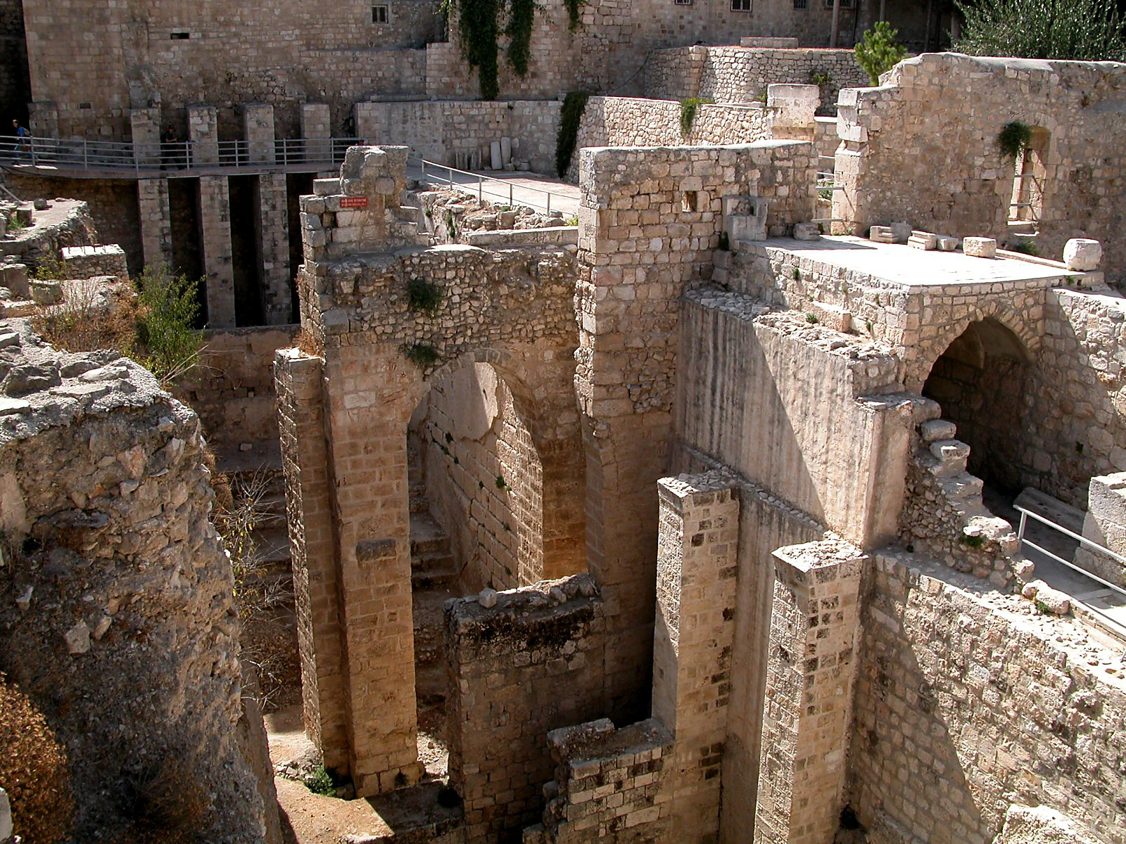
Exodus 34.21 [NIV]: “Six days you shall labor, but on the seventh day you shall rest; even during the plowing season and harvest you must rest.”
Photo ©2006 Todd Bolen; BiblePlaces.com

Slide 9
Jeremiah 17.21-22 [NIV]: “This is what the LORD says: Be careful not to carry a load on the Sabbath day or bring it through the gates of Jerusalem. Do not bring a load out of your houses or do any work on the Sabbath, but keep the Sabbath day holy, as I commanded your ancestors.”

Slide 10
Nehemiah 13.15-17 [NIV]: “In those days I saw people in Judah treading winepresses on the Sabbath and bringing in grain and loading it on donkeys, together with wine, grapes, figs and all other kinds of loads. And they were bringing all this into Jerusalem on the Sabbath. Therefore I warned them against selling food on that day. People from Tyre who lived in Jerusalem were bringing in fish and all kinds of merchandise and selling them in Jerusalem on the Sabbath to the people of Judah. I rebuked the nobles of Judah and said to them, ‘What is this wicked thing you are doing-- desecrating the Sabbath day?’”

Slide 11
John 5.9b-13: (Now that day was a Sabbath.) So the Jewish leaders said to the man who had been healed, “It is the Sabbath, and you are not permitted to carry your mat.” But he answered them, “The man who made me well said to me, ‘Pick up your mat and walk.’” They asked him, “Who is the man who said to you, ‘Pick up your mat and walk’?” But the man who had been healed did not know who it was, for Jesus had slipped out, since there was a crowd in that place.

Slide 12
John 5.14: After this Jesus found him at the temple and said to him, “Look, you have become well. Don't sin any more, lest anything worse happen to you.”

Slide 13
John 9.1-3 [NET] says, “Now as Jesus was passing by, he saw a man who had been blind from birth. His disciples asked him, ‘Rabbi, who committed the sin that caused him to be born blind, this man or his parents?’ Jesus answered, ‘Neither this man nor his parents sinned, but he was born blind so that the acts of God may be revealed through what happens to him.’”

Slide 14
John 5.14: After this Jesus found him at the temple and said to him, “Look, you have become well. Don't sin any more, lest anything worse happen to you.”

Slide 15
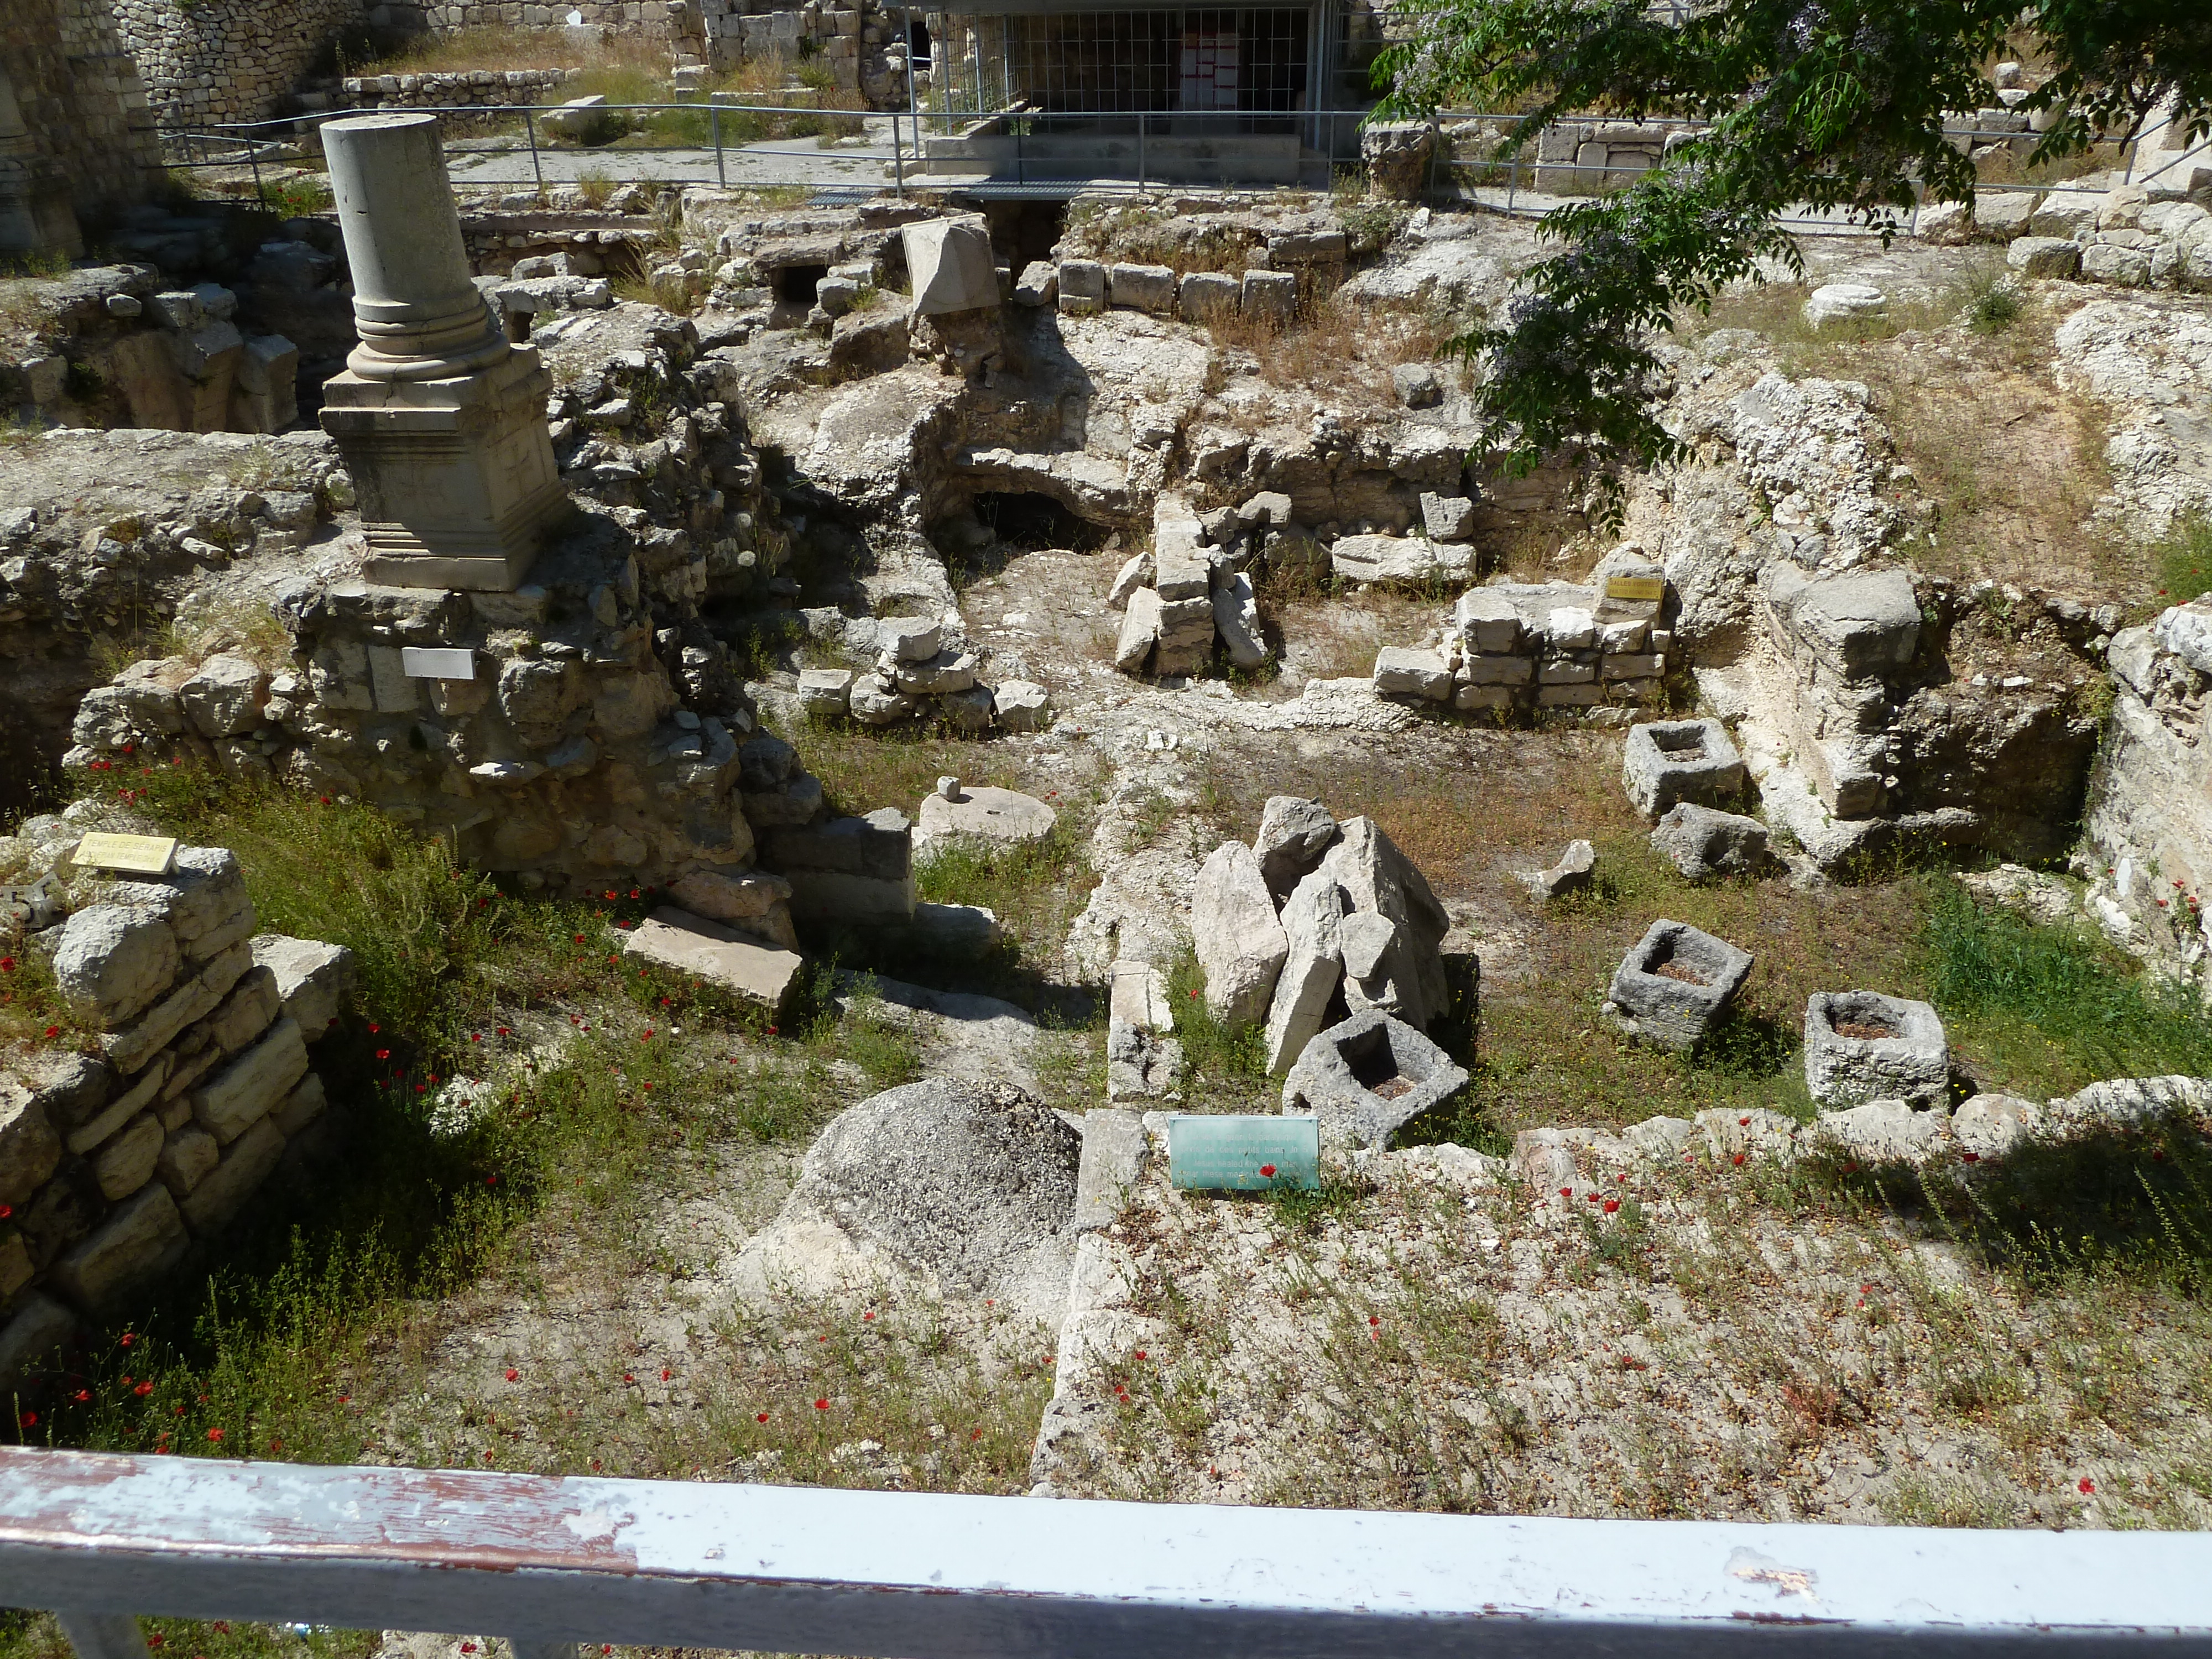
John 5.15-16: The man went away and informed the Jewish leaders that Jesus was the one who had made him well. Now because Jesus was doing these things on the Sabbath, the Jewish leaders began persecuting him.

Slide 16
John 5.17-18: So he told them, “My Father is working until now, and I too am working.” For this reason the Jewish leaders were trying even harder to kill him, because not only was he breaking the Sabbath, but he was also calling God his own Father, thus making himself equal with God.

Slide 17
Exodus 20.9-11 [NIV]: “Six days you shall labor and do all your work, but the seventh day is a sabbath to the LORD your God. On it you shall not do any work, neither you, nor your son or daughter, nor your male or female servant, nor your animals, nor any foreigner residing in your towns. For in six days the LORD made the heavens and the earth, the sea, and all that is in them, but he rested on the seventh day. Therefore the LORD blessed the Sabbath day and made it holy.”

Slide 18
Sabbath Essentials
Christians do not celebrate the Jewish Sabbath.
New Testament teaching to Christians does not specify honoring the Sabbath.
In the Mosaic Law, God desired people to take one out of seven days off from their work, to rest and to focus on God.

Slide 19
Sin can cause illness; Jesus can heal us.
Jesus can heal anyone of anything at any time.
Jesus honored the Sabbath; we honor him.

